Slide 1
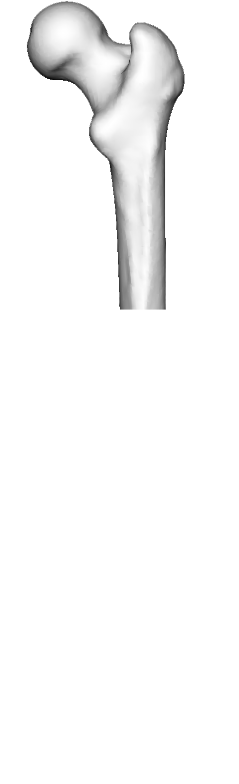
Probabilistic Surface Reconstruction with Unknown Correspondence
Dennis Madsen, Thomas Vetter and Marcel Lüthi
Partial observation

Slide 2
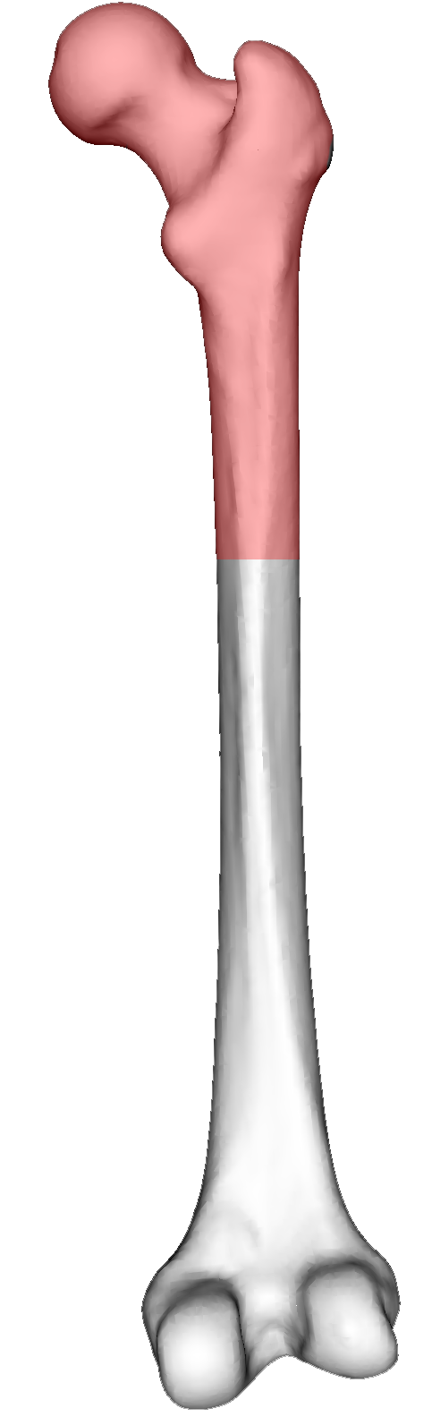
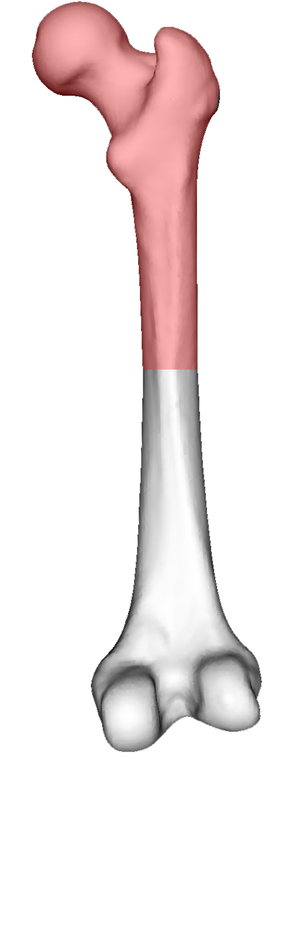
Probabilistic Surface Reconstruction with Unknown Correspondence
Dennis Madsen, Thomas Vetter and Marcel Lüthi
Most likely reconstruction?
Surface reconstruction(s)
Partial observation
Notes:
Given a partial surface observation, which surface reconstruction is then most likely?
Mention applications to state importance:
- Medical for more accurate implant design
- Forensic for identification purposes (e.g. gender)
We frequently encounter the need to reconstruct the full 3D surface from a given part of a bone in areas such as orthopaedics and surgical planning

Slide 3
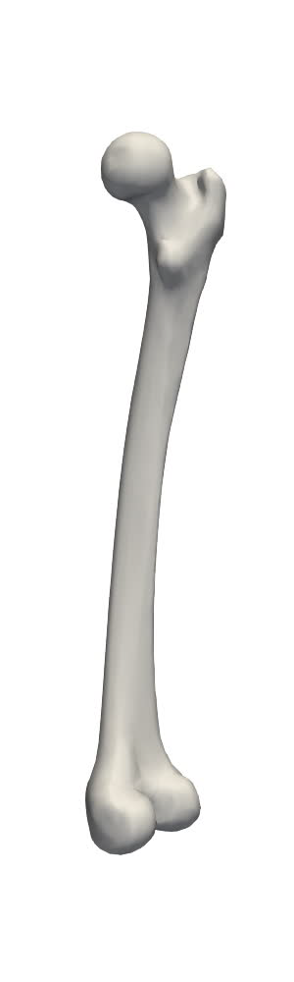
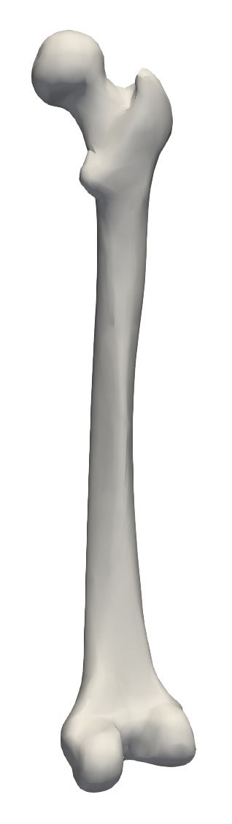
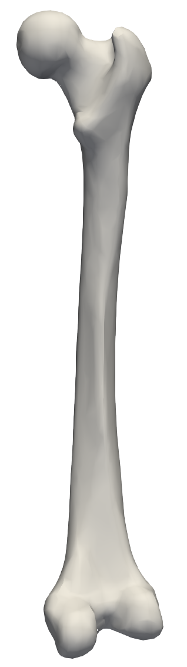
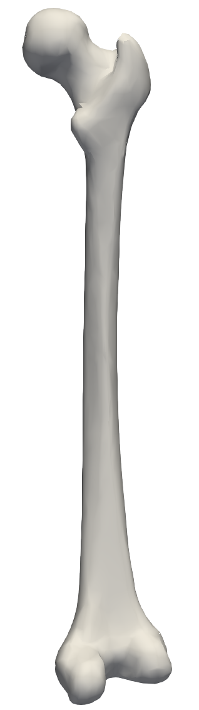
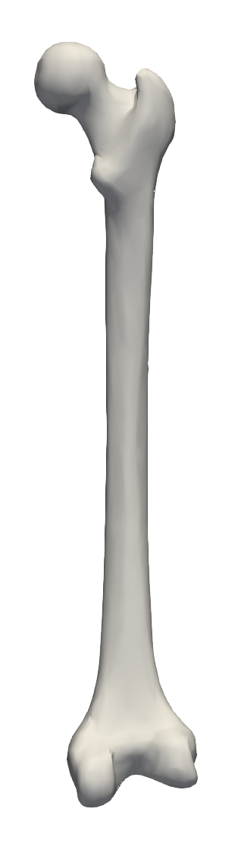
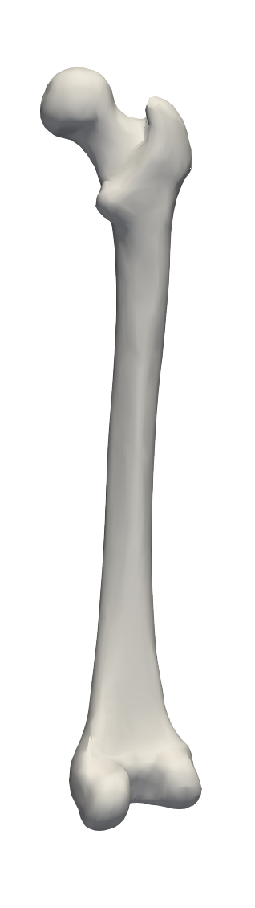
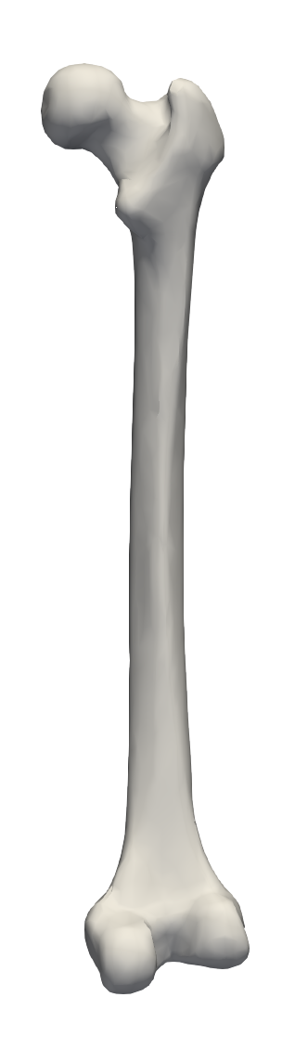
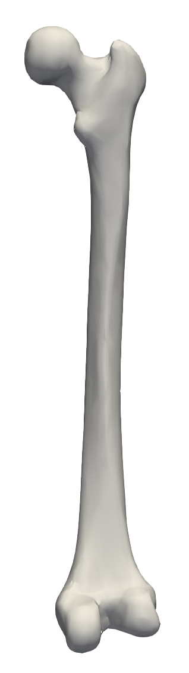
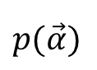
Statistical Shape Models (SSMs)
$$p(\vec{α})$$
An SSM learns the shape variability from example data in point corresondence
PCA
Probabilistic Surface Reconstruction with Unknown Correspondence
Notes:
Statistical shape models can be used to analyse partial data and directly infer the missing piece.
An SSM is a model learned from example data in correspondence

Slide 4
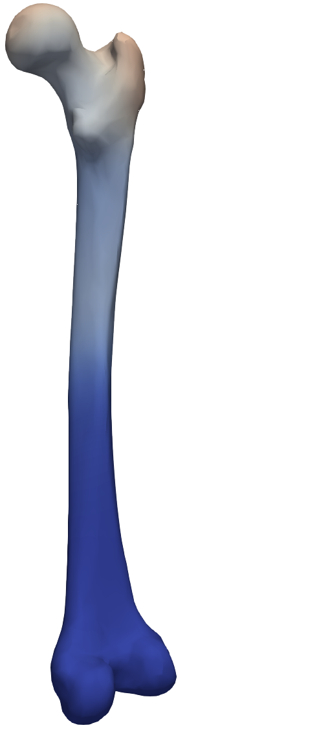
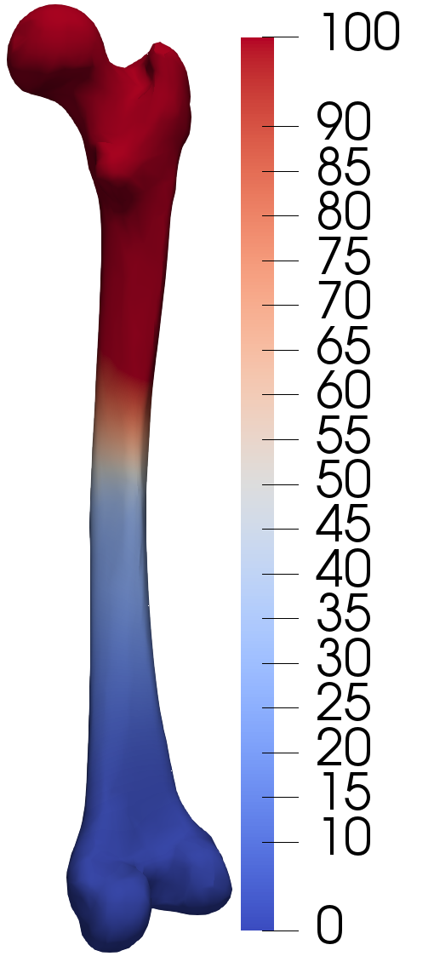
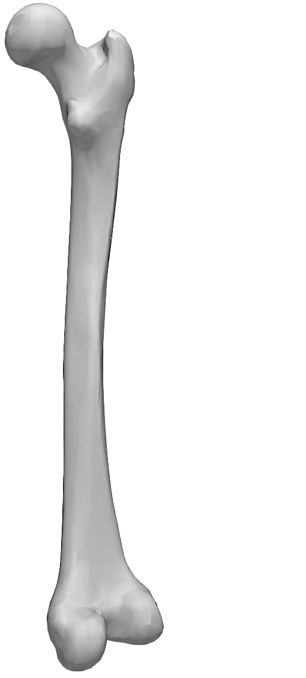
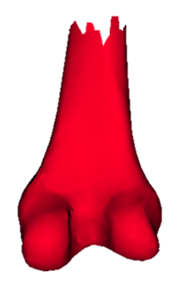
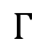
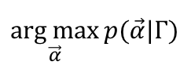
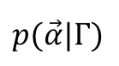
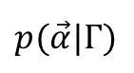
Surface Reconstruction methods
state of the art
OURS
Most likely solution
analytical methods
Sum of landmark variance (mm)
$$\underset{\vec{α}}{arg max}{p(\vec{α}|Γ)}$$
$$p(\vec{α}|Γ)$$
Sampling based method
Partial data
$$p(\vec{α}|Γ)$$
$$Γ$$
Fixed correspondence assumption.
No pose variation.
No correspondence
assumption.
Includes pose variation.
Probabilistic Surface Reconstruction with Unknown Correspondence
Notes:
Finding correspondence between the partial shape and the SSM.
Inferring the missing part from the model.
When reconstruction, the most common method is to find the MAP (a single solution) to the problem.
If we use fixed correspondence, a closed form solution can be used (current state of the art)
Our solution, does not make any assumption on the correspondence!

Slide 5
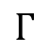
Point Correspondence uncertainty
Partial data
$$Γ$$
Probabilistic Surface Reconstruction with Unknown Correspondence
Notes:
Fixed correspondence is a too naïve assumption – especially when working with smooth surfaces.

Slide 6
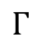
Method comparison Length estimation of Femur
Partial data
$$Γ$$
Analytical
Sampling
Ours
Probabilistic Surface Reconstruction with Unknown Correspondence
Notes:
Examples of length prediction where the analytical method has the ground-truth bone length as highly unlikely.
With our method, the ground-truth solution appears with a higher probability

Slide 7
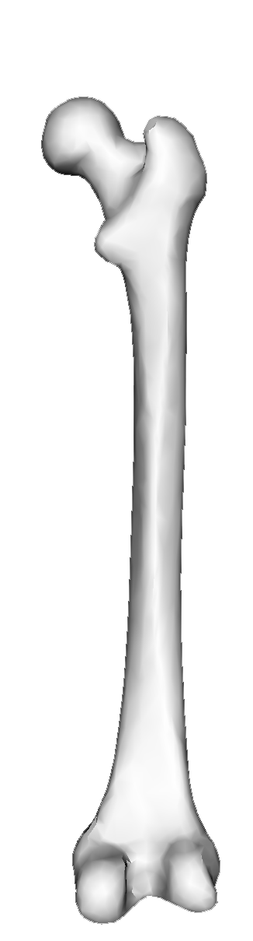
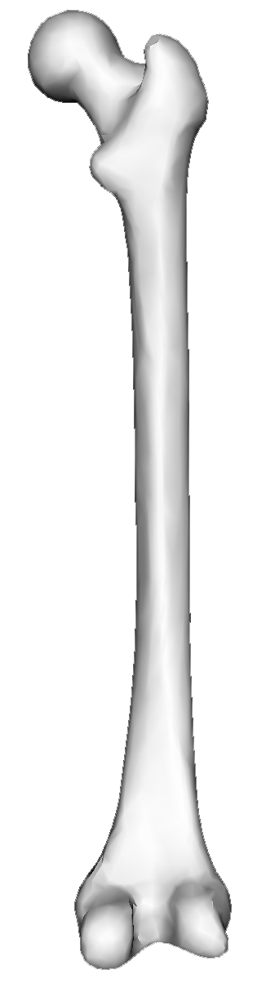
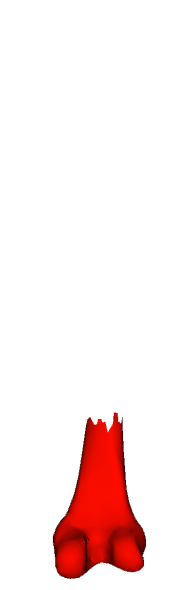
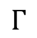
We represent the Posterior distribution as a Markov-Chain with the Metropolis Hastings algorithm
Technical contribution Geometry informed proposal for fast convergence
Short bone reconstruction
Correspondence
Long bone reconstruction
Partial data
$$Γ$$
=> Poster
Two random samples
Probabilistic Surface Reconstruction with Unknown Correspondence
Notes:
We make use of a MCMC method to estimate the posterior distribution as a markov chain.
Random samples from the posterior shows that the correspondence is not fixed around the known part of the bone.
As a technical contribution, we introduce a geometry informed proposal into the MH algorithm for faster posterior convergence.
For more info, see poster.

